Slide 1

IBM Applied Data Science Capstone
ChengCheng Wang

Slide 2
New York City is one of the most popular and largest cities in the United States. Many restaurants and buildings are being constructed for business. The audience is looking to find a location that is best suit for Chinese restaurant.

Slide 3
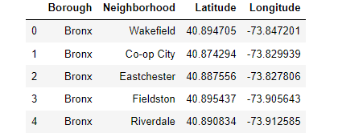
Data
The data that will used for this problem is New York City neighborhood and boroughs. The dataset should also contain with latitude, longitude, and venue. The URL I used for data collection is from Wikipedia and here is the link: https://cocl.us/new_york_dataset. I included four columns in the dataset, which are borough, neighborhood, latitude, and longitude. Here is the dataset:

Slide 4
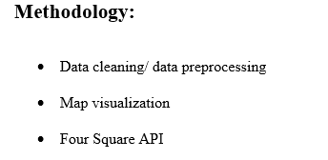

Slide 5
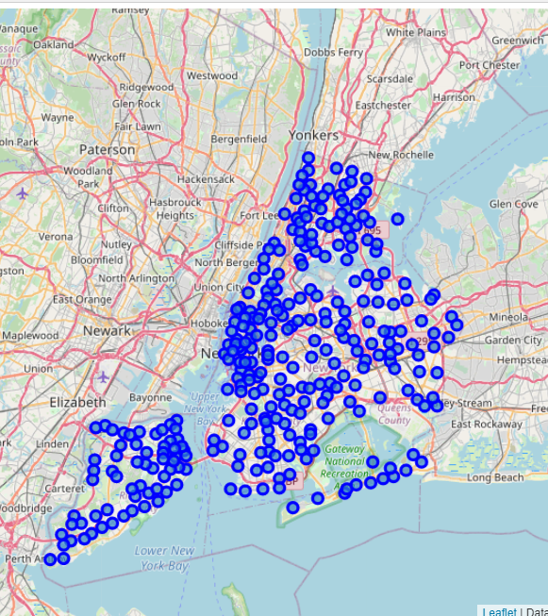
After data cleaning, there are total of 306 neighborhoods and 5 boroughs in the dataset. The geographical coordinate of NYC is 40.7127281, -74.0060152. Here is a map of New York contains neighborhoods and boroughs.

Slide 6
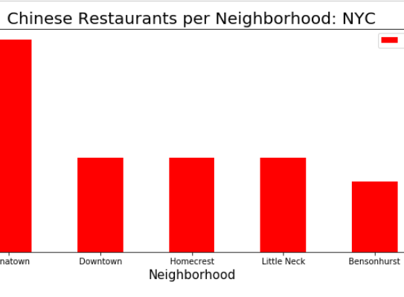
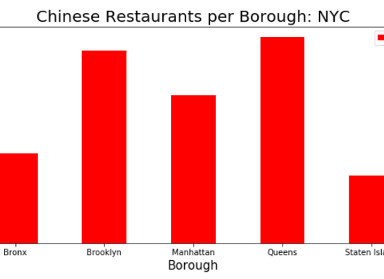
Most popular Chinese food Neighborhood and Borough

Slide 7
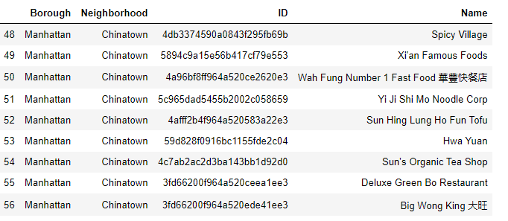
There are total of 9 Chinese restaurants in Chinatown and Here are the names:

Slide 8
Results
There are total of 157 Chinese restaurants in NYC. Queen and Brooklyn are the two most popular boroughs in NYC. Chinatown is the most popular neighborhood in NYC that contains the highest number of Chinese food, which is 9.

Slide 9
Conclusion
In conclusion, in order to find the best location to start a Chinese restaurant, Chinatown is a good option since it is the most popular neighborhood that contains the largest number of Chinese restaurant. Boroughs such as Queens and Brooklyn can also be good options to start a Chinese restaurant. Even though Manhattan is also popular, the land price will be much more expensive to other neighborhoods.

